Slide 1
Intraspecific co-operative responses

Slide 2
Group formation
Advantages of group behaviour
Hunting.
Many animals (e.g. wolves, lions, and wild dogs) hunt as a team.
Wild dog hunters fill their stomachs with the kill, then return and regurgitate it for the puppies and nursing bitches.

Slide 3
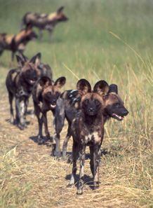
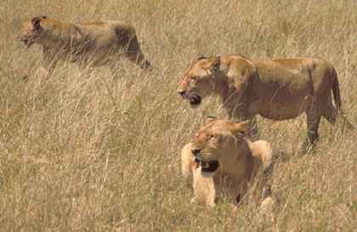
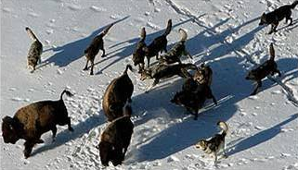
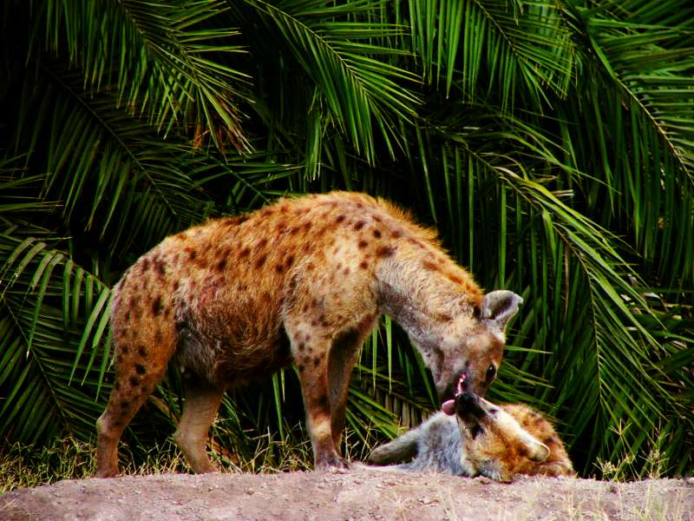

Slide 4
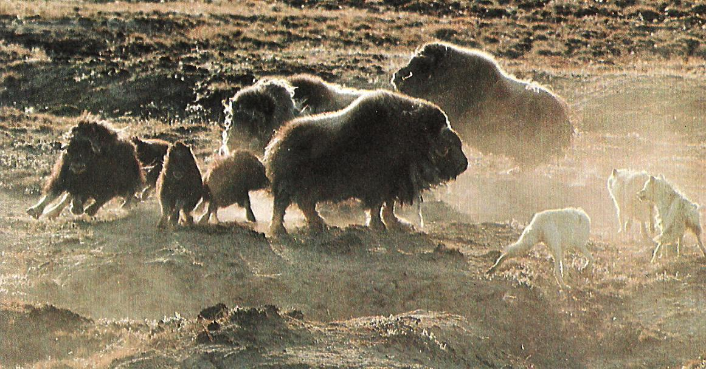
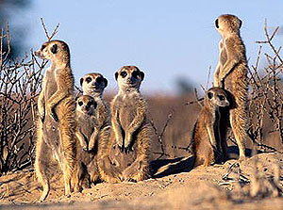
Defence.
Himalayan yaks and Arctic musk oxen form defensive circles to resist predators.
Groups of animals such as baboons and meerkats post guards to watch for danger so that the rest of the group can eat in peace.

Slide 5
3. Protection.
Dolphins protect mothers during the birth process, and help to carry the new baby to the surface until it has learned to breathe. They also aid injured members.

Slide 6
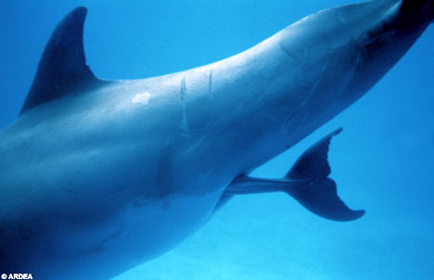
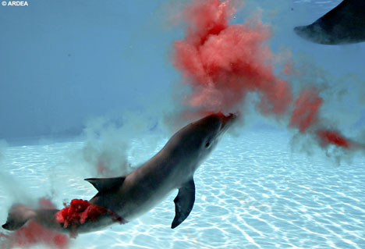
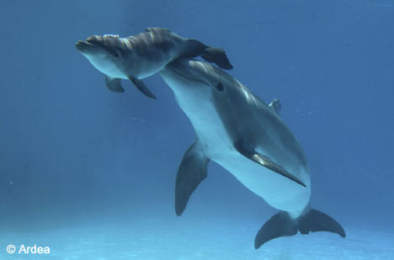
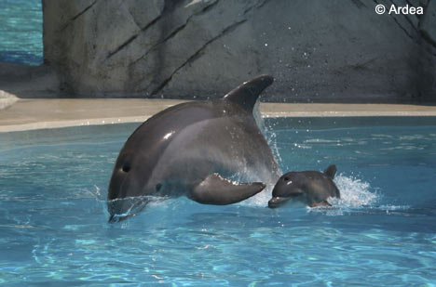

Slide 7
Protection (cont’d)
In baboon packs the females and babies are placed in the safest position. The males ring and guard their retreat, with the alpha male organising the defences

Slide 8
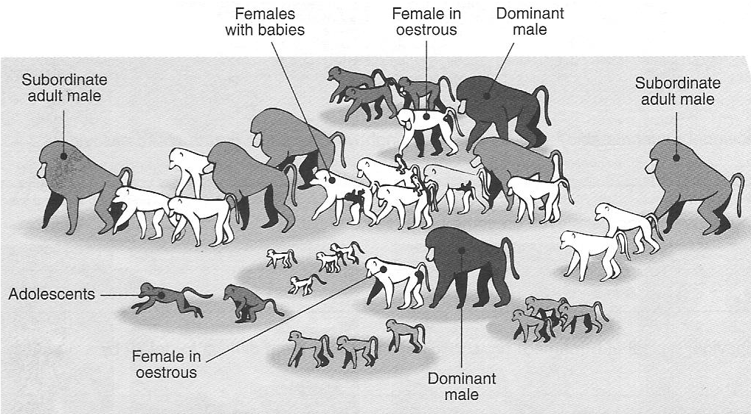
At rest or on the move, the dominant male baboons are in the centre with the females and the young, while the subordinate males take up positions at the front and back of the group, to bear the brunt of an unexpected attack. On the offensive, the dominant males emerge from the centre of the group and take up positions at the front, leading the other males in the attack or controlling an organised retreat to allow the females and young to escape.

Slide 9
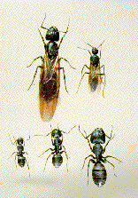
4. Insect societies.
Insects have taken group formation to the extreme: a colony of ants or bees is specialised to carry out all aspects of maintenance of the nest or hive. This is centred around the queen, who coordinates the group with pheromones.
Top left--Queen
Top right--Male
Bottom left--Minor worker
Bottom middle--Intermediate worker
Bottom right--Major worker.

Slide 10
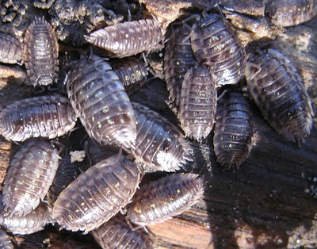
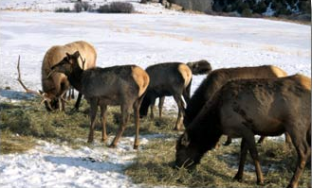
5 Clumping.
Woodlice cluster together to conserve moisture.
Some birds and shaggy elks, cluster together to conserve heat.

Slide 11
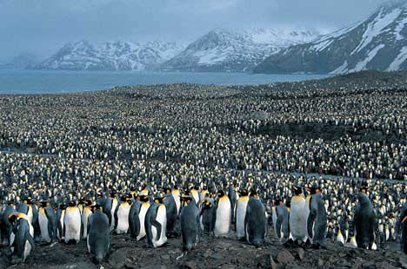
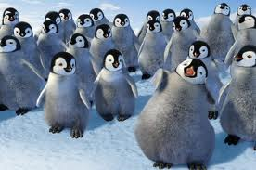
Penguins cluster to conserve heat too

Slide 12
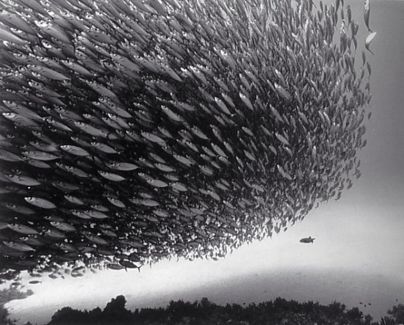
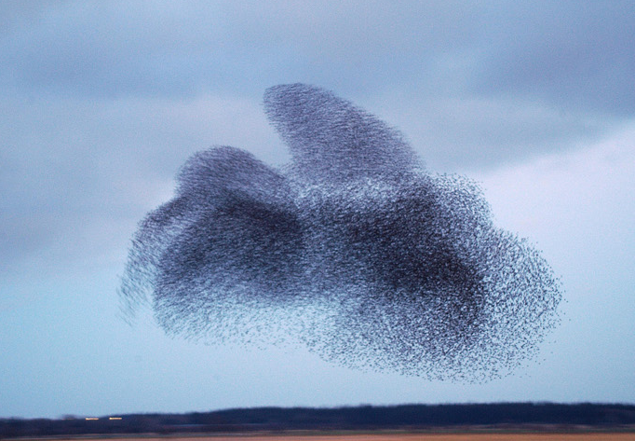
6 Confusion.
Large shoals of fish, which turn rapidly with sparkling scales, confuse predators. Flocking of birds (e.g. starlings) has the same effect.

Slide 13
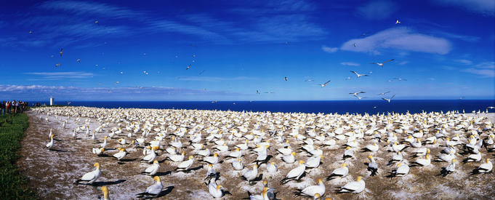
7. Breeding.
Many groups form for breeding purposes, e.g. penguins, gulls, and gannets. The safest breeding sites are in the centre of the group.

Slide 14
Disadvantages of group behaviour
Crowding together increases competition for all resources.
Disease can spread quickly through a close group.
Parasites (which often carry disease) can spread more easily.
Crowding increases conflict between group members.
Some (or many) males may miss out on mating as only alphas mate
Some danger of harm to infants if parents are deposed

Slide 15
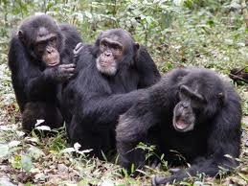
Altruism
Risking self to help unrelated individuals
E.g. group hunting or defence
Benefits whole group and hence the altruistic individual

Slide 16
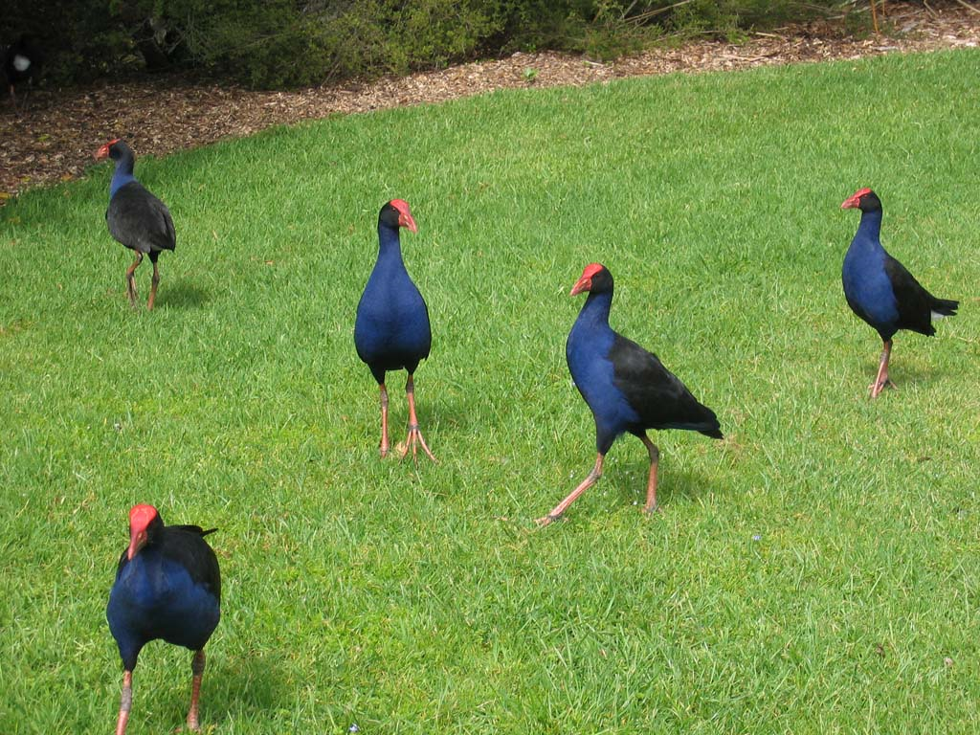
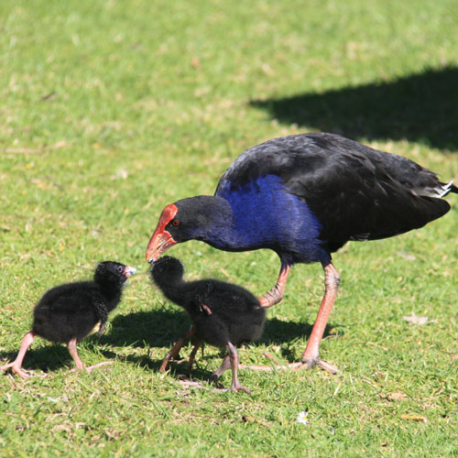
Kin Selection
Altruism toward related individuals
E.g. help rearing younger siblings

Slide 17
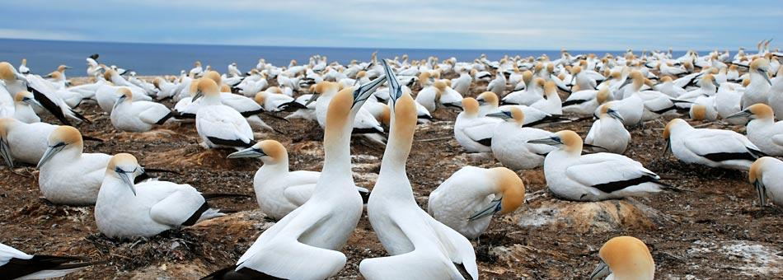
Courtship and pair-bond formation
Most animals keep individual distances from others. Invading this personal space is a threat.
The sex act requires:
  co-operation
  the temporary suppression of aggressive behaviour
  a system of communication, and species recognition.

Slide 18
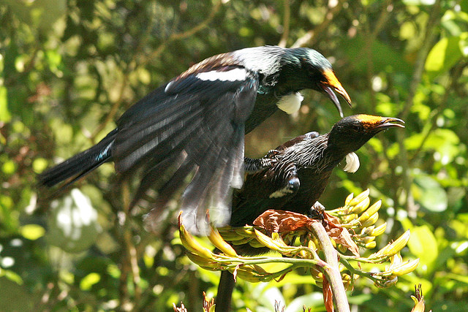
The partners must make sure they are:
  of the same species
  opposite sex
  both fertile
  both fully prepared to mate.

Slide 19
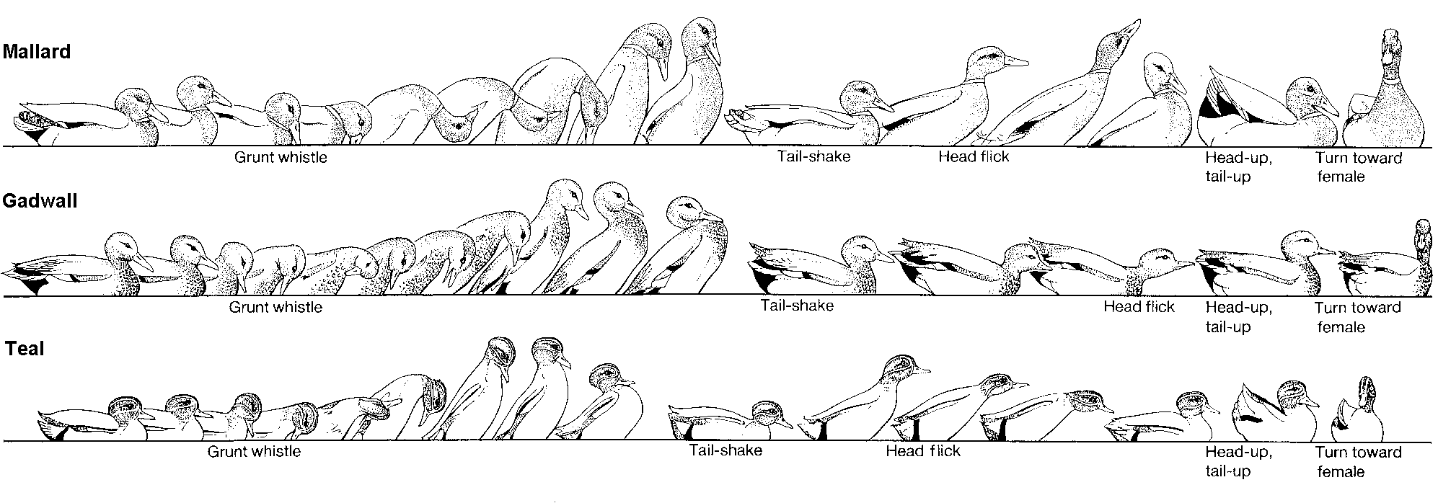
Mating rituals of some species of duck

Slide 20
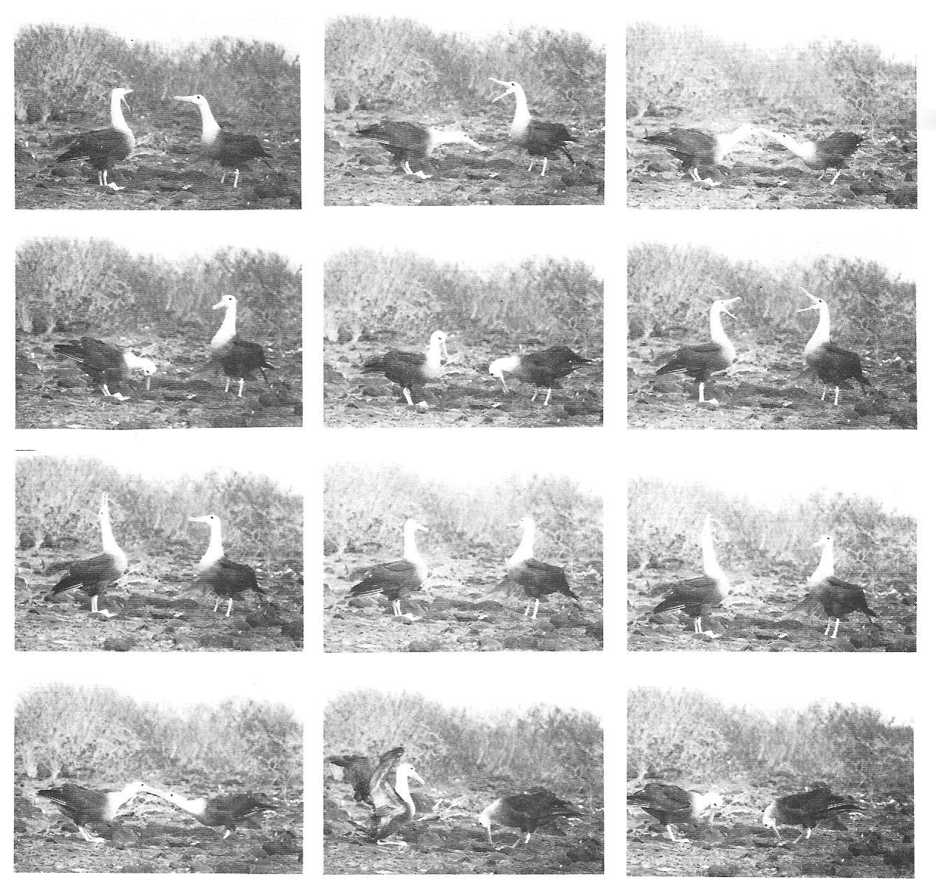
Albatross courtship ritual

Slide 21
Usually the female chooses the male, and the male must compete for her. There are two ways that a male can gain an advantage over another male:
1. Compete with other males by fighting or ritualised combat.
2. Compete indirectly in attracting females by special displays and adornments.

Slide 22
Sexual competition between males has led to the evolution of brilliant breeding colours, ornaments, antlers and other features that make the male more desirable to the female.
Male—male dominance encounters let the female judge the ‘fitness’ of the males.
Some rituals allow the potential male suitors to size up the opposition without actually fighting.

Slide 23
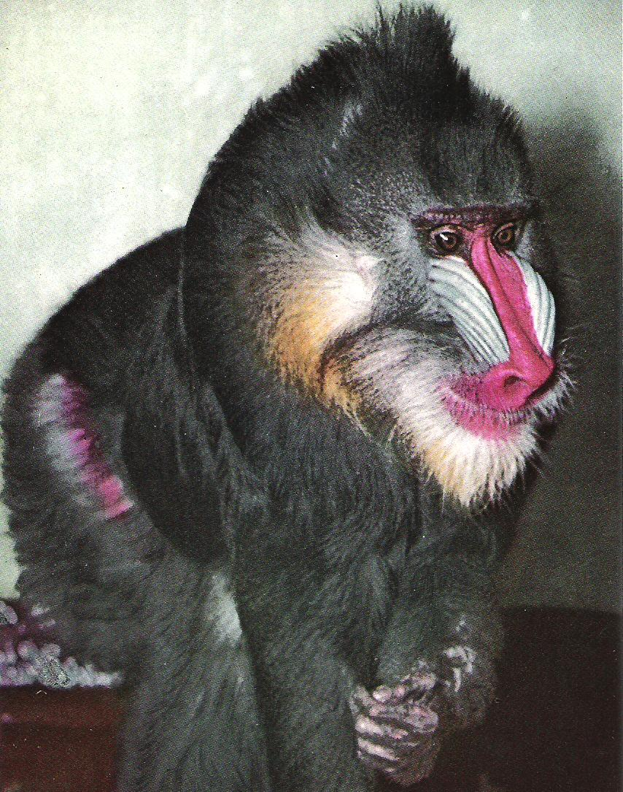
A male Mandrill

Slide 24
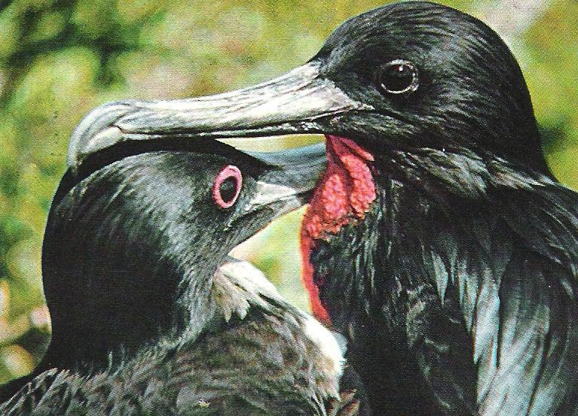
Frigate birds

Slide 25
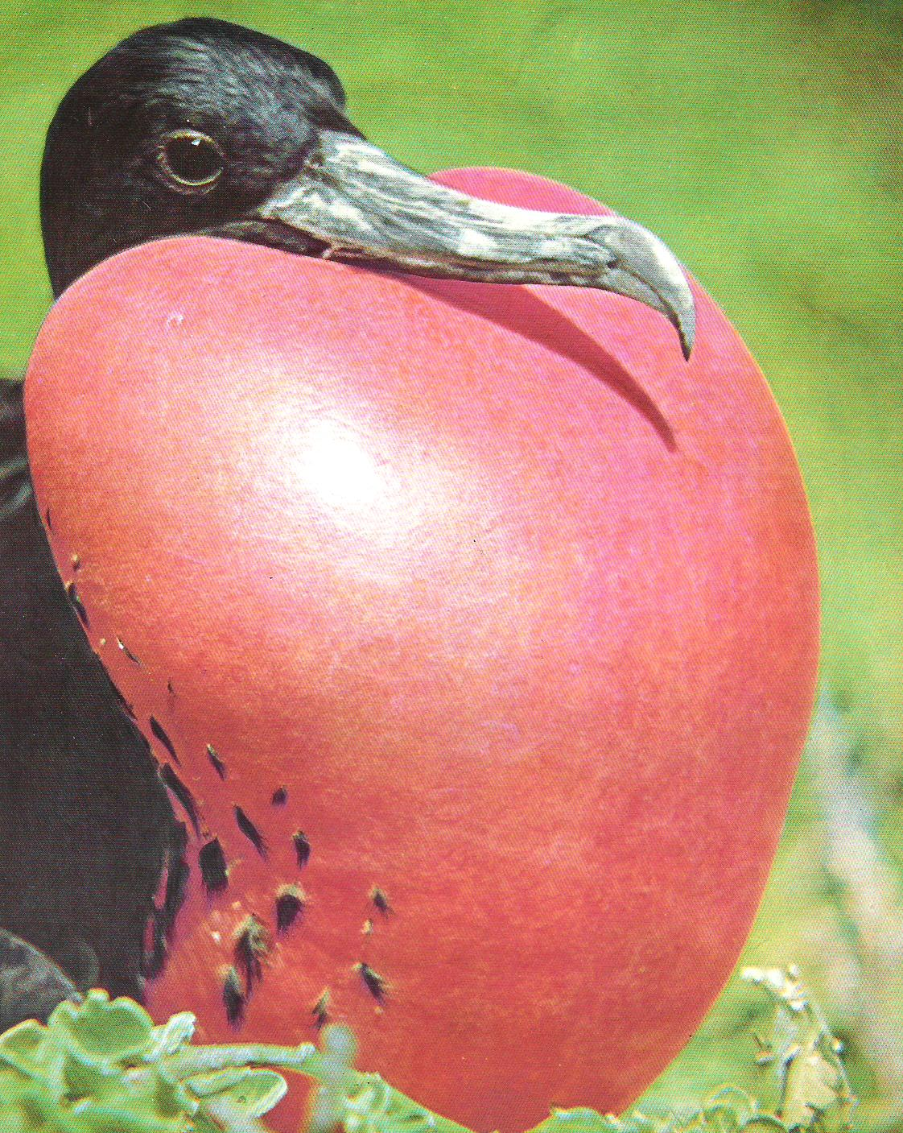

Slide 26
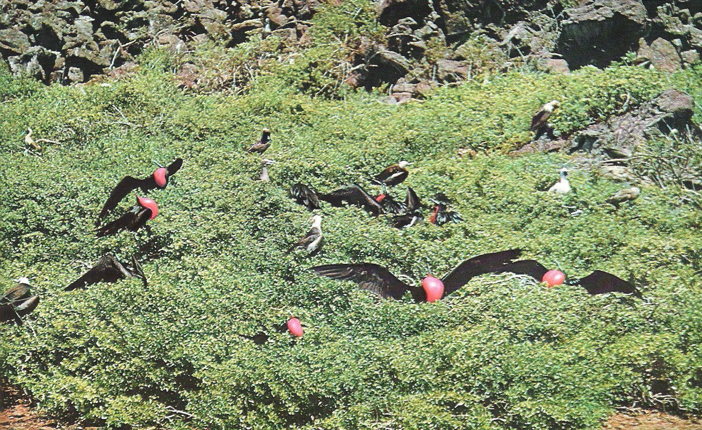

Slide 27
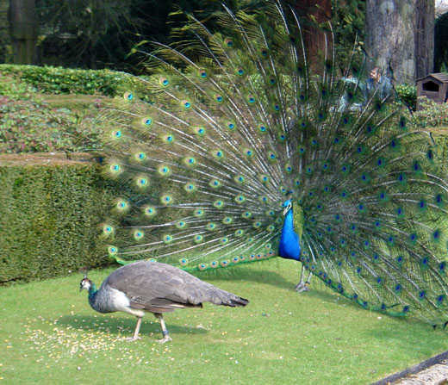

Slide 28
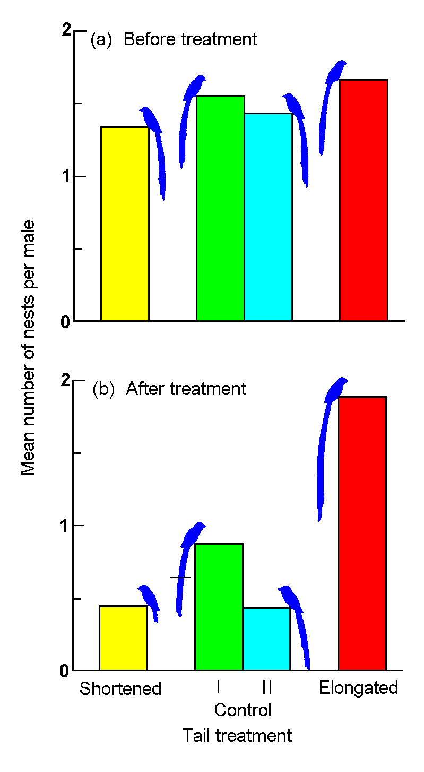
The importance of having a big tail
Female long-tailed widow birds from Kenya prefer to mate with longer tailed males
The males either had their tails shortened, lengthened, cut off and replaced (control I) or left alone (control II).

Slide 29
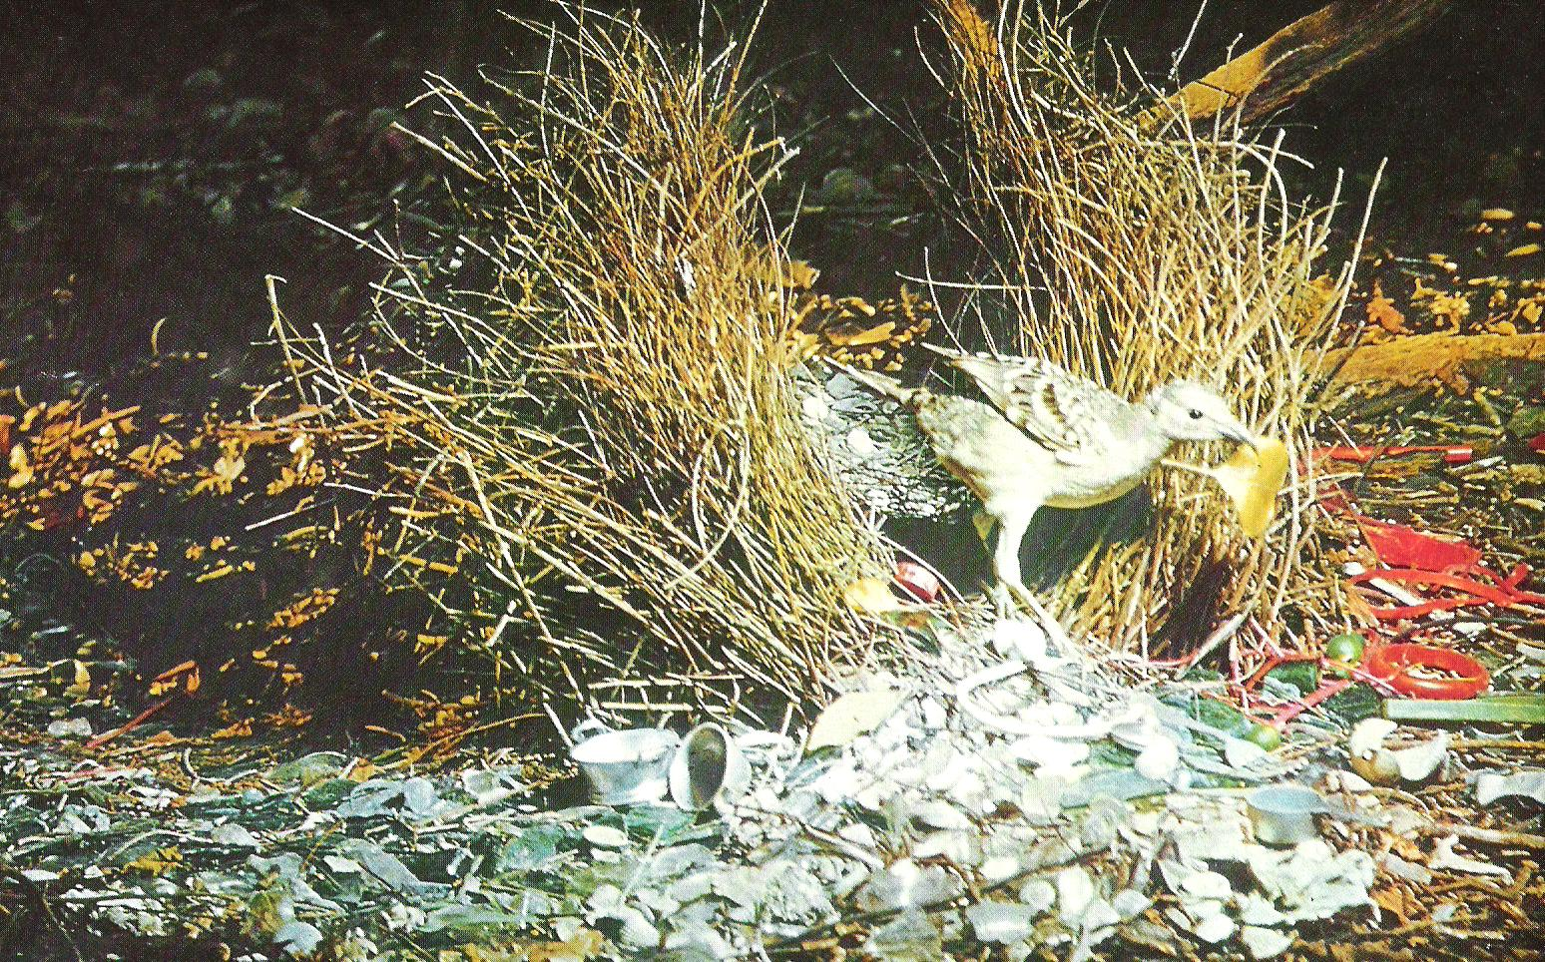
Oh those Aussie bower birds

Slide 30
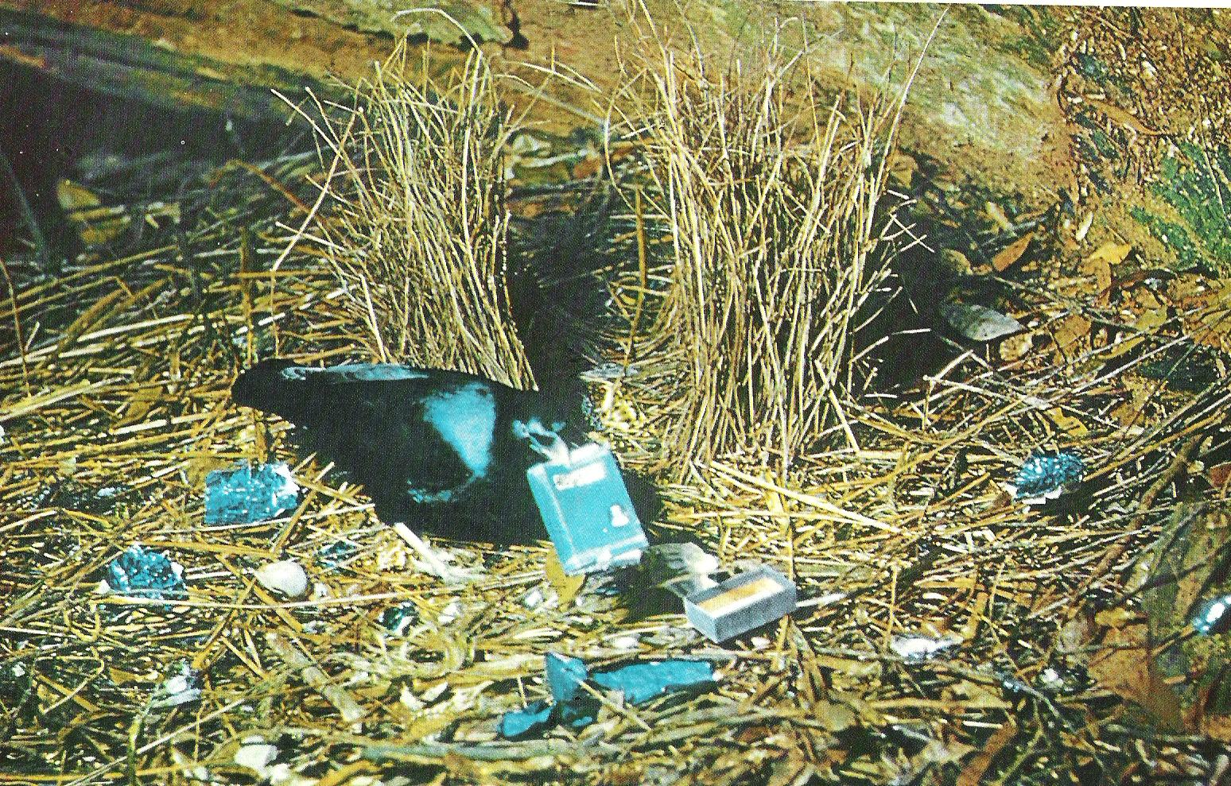
Or if that didn’t impress you

Slide 31
Red deer stags roar on the boundaries of their territories to let the other males know just how strong they are, as roaring endlessly takes a lot of effort and the stag must be in good condition. They round up the females as a harem, with the strongest male having the most females. The roaring turns into strutting parallel to each other then, if both males think they are as strong as the rival, it can turn into a fight — but more often than not one of the males will retire, so fighting is avoided.

Slide 32
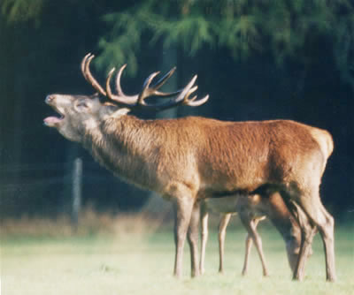

Slide 33
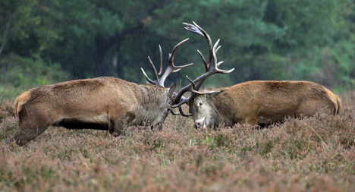
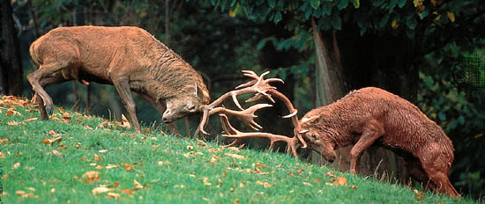

Slide 34
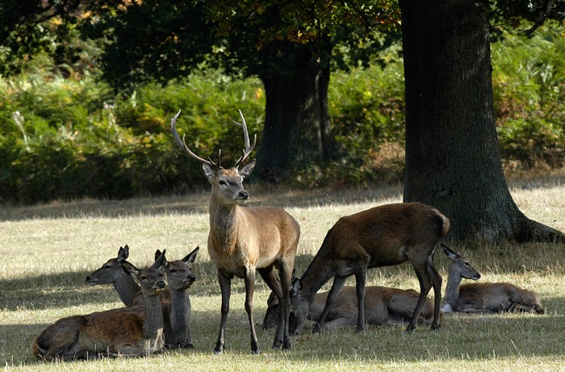
And to the winner …..

Slide 35
Kakapo
Kakapo are the only parrots in the world that have a lek breeding system. Males loosely gather in an arena and compete with each other to attract females to mate. Females watch the males display or lek. They choose a mate based on the quality of his display; they are not pursued by the males in any overt way. No pair bond is formed and males and females meet only to mate.

Slide 36
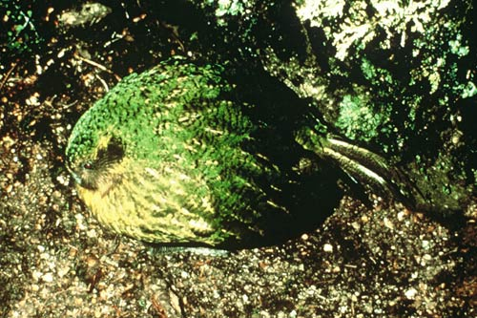
A male booming

Slide 37
Courtship may be a sign to start nest building or to trigger ovulation.
Aggression is reduced by dances, calls, movements of the whole or part of the body in ritualised sequences, release of chemical pheromones, or touching. This allows the pair bond to strengthen, so more intimate behaviours become possible.
In many arthropods such as spiders, the female has to be appeased so that she does not make the male her wedding breakfast!

Slide 38
Pair bond
A stable relationship between animals of the opposite sex that ensures co-operative behaviour in mating and the rearing of the young.

